Slide 1

2 chronicles 20:1 – 23:21
A CD of this message will be available (free of charge immediately following today's message
This message will be available via podcast later this week at calvaryokc.com

Slide 2
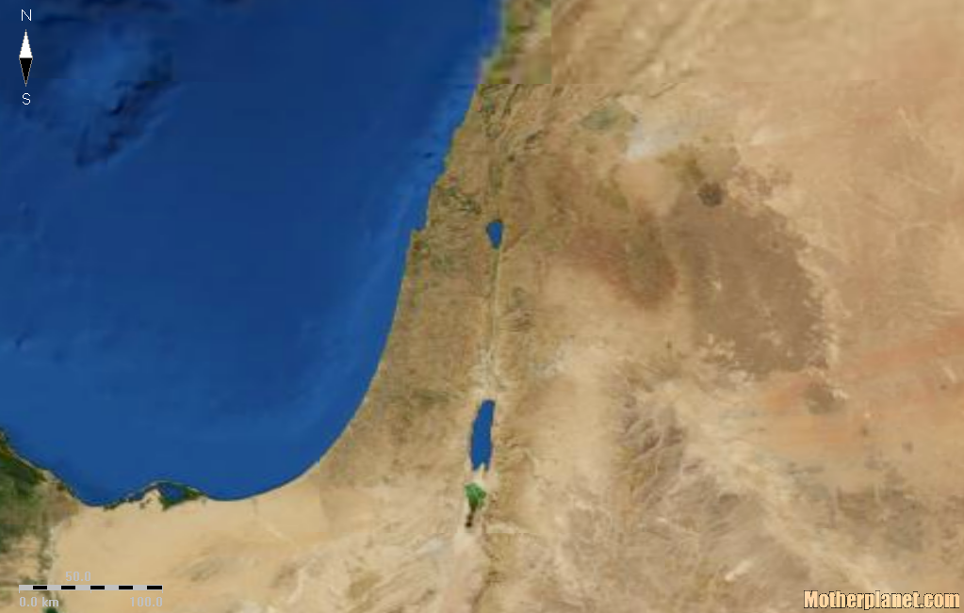
2 chronicles 20:1 – 23:21
Syria
(Aram)
Ammon
Ein Gedi
Moab

Slide 3
2 chronicles 20:1 – 23:21
John 15:5 ~ I am the vine, you are the branches. He who abides in Me, and I in him, bears much fruit; for without Me you can do nothing.

Slide 4
2 chronicles 20:1 – 23:21
Beauty of holiness ~ NASB, in holy attire

Slide 5
2 chronicles 20:1 – 23:21
David Y
1910-970BC
Solomon Y
970-930BC
Jehoram
847-840BC
Asa
911-871BC
Queen Athaliah
840-835BC
1000 BC
950 BC
900 BC
850 BC
800 BC
750 BC
700 BC
650 BC
600 BC
550 BC
500 BC
Rehoboam
930-914BC
Jehoshaphat
871-847BC
Abijam
914-911BC
Azariah
840BC
Y | Ruled over united kingdom
Note: Some dates are approximate. Reigns do not include co-regencies
Kings of
Judah

